Slide 1




Coder: Will Hobbs

Slide 2
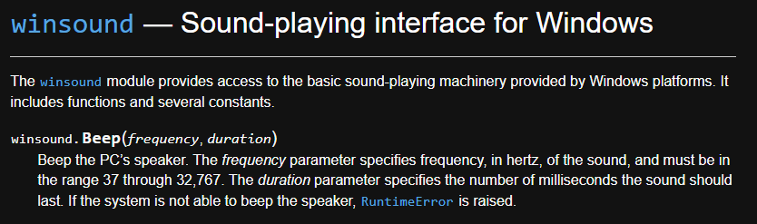
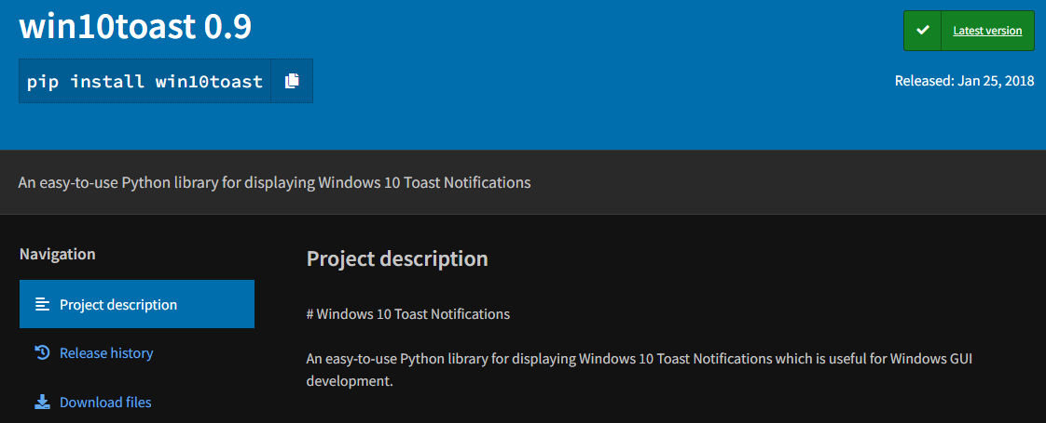
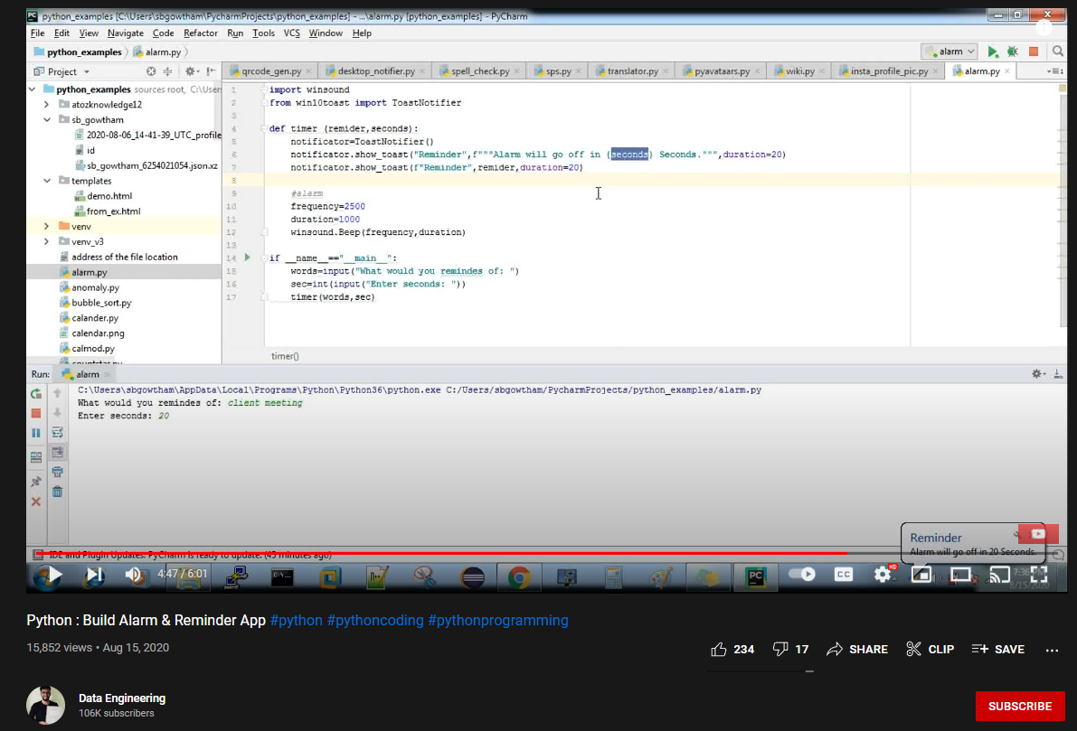
The Idea
Create a simple yet effective reminder app using Python in VS Code
Source Code/Inspiration:

Slide 3

Project Development
Tough to find source code that fit my needs
Scope change: Maybe the app doesn’t have to be so specialized
Roadblocks
confusing error codes
issues figuring out how to integrate “datetime” library
generally inexperienced

Slide 4
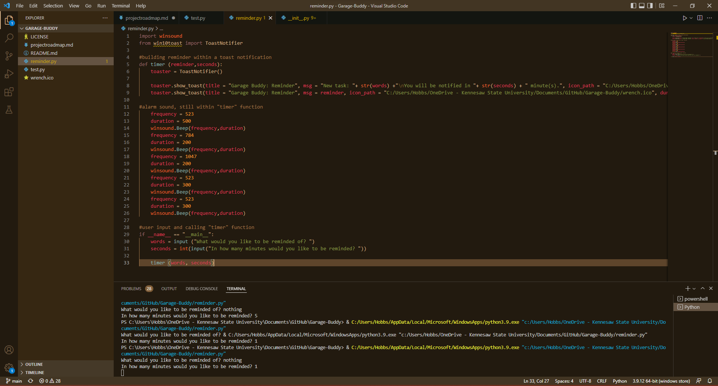
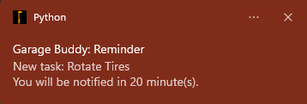

The Code

